Slide 1
Analysis on Dataset for Udemy online courses

Slide 2
OVERVIEW OF PROJECT
This project is focused on an online learning platform.
The dataset provided was from Udemy which contains
3672 data comprising the subjects (Business Finance, Graphic Design, Musical Instruments and Web Design) subscribed from 2011 to 2017.

Slide 3
The Data Science Process
Business Understanding
Data Retrieval
Data Exploration
Data Cleaning
Business Rules & Hypothesis
Analyze Data
Presentation
Productionalize Analysis

Slide 4
Data cleaning
The data used for this project is the structured data with few missing or null values. We will use the data cleaning or imputation techniques for the missing values imputation. Duplicate values are removed from the dataset.
We also noticed some outliers in subject web development in relation to the number of subscribers. This was identified using box plots and scatter plots.

Slide 5

Hypothesis
The number of subscribers for paid Udemy courses are decreasing over the years

Slide 6
QUESTIONS
This is to help in gathering information for analysis.

Slide 7
Do longer courses have fewer subscribers?
Do the courses with expert and intermediate levels of difficulty have fewer subscribers?
Are the number of people subscribing to paid courses decreasing?
Are the longer courses paid or free?
Are there more subscribers doing paid courses than those doing free courses?
Do courses with higher reviews have higher number of subscribers?
Do paid courses have more lectures?
Which subject has the most subscribers?
Which subject has the most paid courses?

Slide 8
Visualisations
Using visuals to explain findings on the dataset

Slide 9
Trend in the number of subscribers for subjects from 2011-2017
 | Business Finance | Graphic Design | Musical Instrument | Web Development | Total for the year
2011 |  |  |  | 119028 | 119028
2012 | 3620 | 100649 | 133635 | 317435 | 555339
2013 | 311664 | 50133 | 150224 | 1211417 | 1723438
2014 | 494626 | 174582 | 156152 | 1105049 | 1930406
2015 | 501858 | 352856 | 190368 | 2430242 | 3475342
2016 | 426647 | 229587 | 148748 | 2161662 | 2966644
2017 | 130299 | 155341 | 67562 | 635739 | 988941

Slide 10
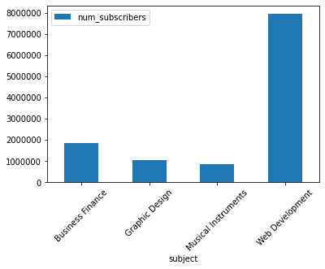
Number of subscribers for each subject

Slide 11
Findings from the number of subscribers for each subject
Web Development significantly has the highest number of subscribers showing that users are generally interested in Web Development courses.
Web development was the first subject introduced in 2011. In view of this, it has more subscribers.
Musical Instruments seem to be the least popular.

Slide 12
A graph showing the total number of lectures, subscribers and reviews per course

Slide 13
From the given data, the number of subscribers increased from 2012 to 2015 and decreased in 2016 and 2017.The decreasing values are as a result of :
New online learning platforms created offering the same services.
Difficulty level of the courses are high i.e. for expert levels.
Number of course reviews keeps decreasing.
Duration of the course videos being long.

Slide 14
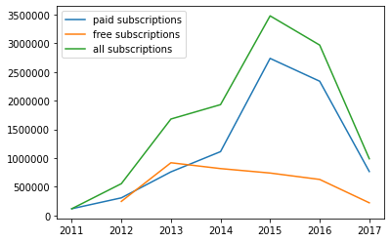
Number of subscribers per year

Slide 15
Number of subscribers for paid and free courses
The number of subscribers for paid courses is 70% and that of free courses is 30%

Slide 16
The plot indicates that the number of paid subscribers is decreasing over the years.
This may be due to the fact that overall number of subscribers are decreasing.
However, it is noticeable that the number of subscribers taking free courses is far lower per year than the free ones.
The number of subscribers taking paid courses is 40% more than those taking free courses.

Slide 17
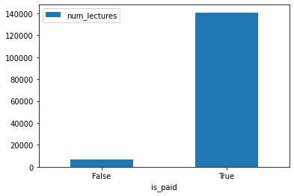
Number of lectures for free and paid courses
From the graph, paid courses have far more lectures in each course than the free ones. This shows that business is making progress.

Slide 18
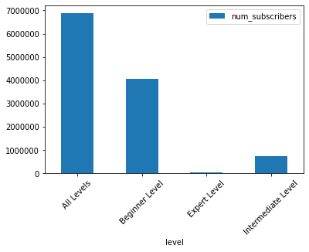
Bar chart showing the number of subscribers for level of difficulty

Slide 19
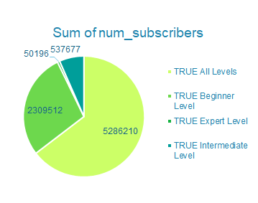
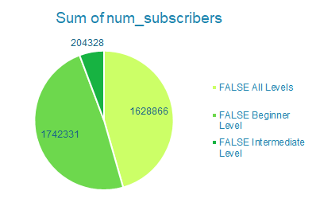
Number of subscribers for level of difficulty
Paid courses Free courses

Slide 20
Findings from the level of difficulty of courses
Expert level courses significantly have the least subscribers.
Intermediate level courses also have less than half the number of subscribers that beginner level courses have.
This indicates that more people subscribe to beginner level courses.

Slide 21
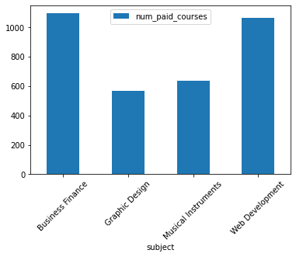
A graph showing the subject with the most paid courses

Slide 22
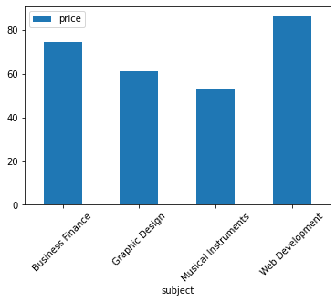
Average price per subject

Slide 23
Findings from subject with the most paid courses and average price per subject
Business Finance subjects have the most paid courses yet have less than half the number of subscribers that Web Development courses have.
Web Development courses have the most number of subscribers and are averagely the most expensive.

Slide 24
Suggestions based on analysis
From the analysis, Udemy can add more subjects which can increase the number of subscribers.
More Business Finance courses should be made free to attract more subscribers.

Slide 25
Conclusion
From the analysis made, there are more paid courses which means Udemy is making profits since the number of subscribers for paid courses are more than that of the free courses.

Slide 26
THANK YOU
PDS - 20

